Slide 1

Power BI Data Quality Checks Using Python & SQL
Kristyna Ferris

Slide 2
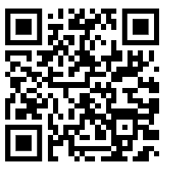

About Me ~ Kristyna Ferris
Senior data engineer consultant at 3Cloud, Lexington Data Technology Group organizer , author on DataOnWheels, co-founder of Data On Rails, and co-host on Kratos BI Wednesday Lunch & Learn YouTube livestream with Chris Wagner.
My experience includes implementing and managing enterprise-level Power BI instances, training teams on reporting best practices, learning new coding languages to hack into Power BI, and building templates for scalable analytics.
Check out my blog: https://dataonwheels.wordpress.com/
Check out my blog platform: https://dataonrailsblog.wordpress.com/
Connect on LinkedIn: https://www.linkedin.com/in/kristyna-hughes-dataonwheels/
Connect on X (Twitter): @data_dragoness
GitHub

Slide 3

Data Quality – Building Trust
The key to useful reporting is adoption.
Consistently incorrect data destroys trust in the data and the report by extension.
The quickest way to rebuild trust is to automate data quality checks and demonstrate ability to catch errors before end users.

Slide 4
Why Python?

Slide 5

Why Python?

Slide 6

Two Worlds Colliding
Coming soon to a workspace near you….Fabric!
Scalability
Automated Testing
Data Quality Reporting

Slide 7
Demo Set Up & Limitations
Azure AD App
Install Python & Add Libraries
Excel Workbook Set Up
Requires authentication to the source DB and dataset in the PBI service
Check out my blog that includes the setup: Power BI: Data Quality Checks Using Python & SQL – Data on Wheels – Kristyna Ferris & Steve Hughes (wordpress.com)

Slide 8
Demo Set Up & Limitations
Azure AD App
Install Python & Add Libraries
Excel Workbook Set Up
Requires authentication to the source DB and dataset in the PBI service
Check out my blog that includes the setup: Power BI: Data Quality Checks Using Python & SQL – Data on Wheels – Kristyna Ferris & Steve Hughes (wordpress.com)

Slide 9
Azure AD App Set Up

Slide 10
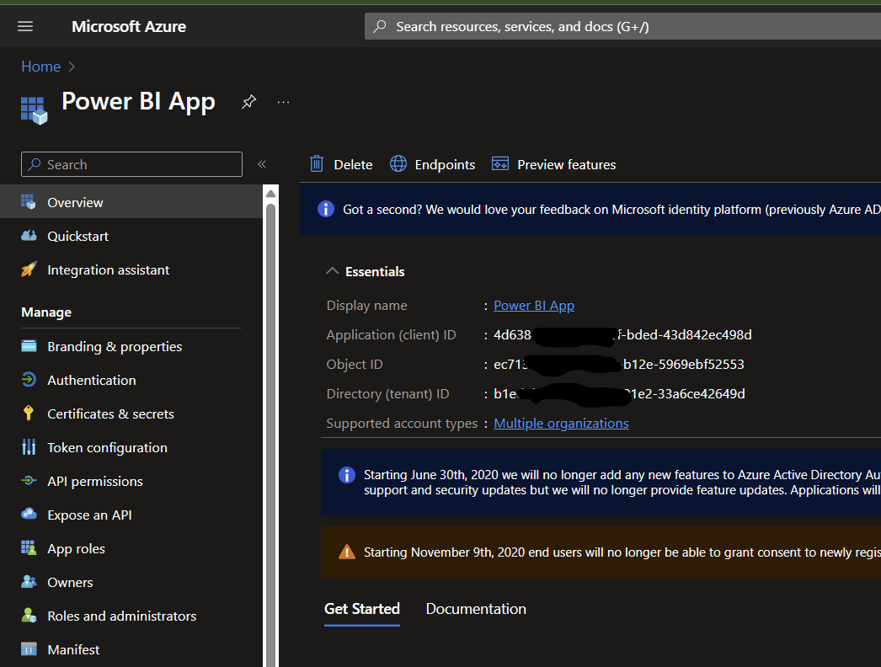
Create App in Microsoft Azure Portal
Create a client secret
Assign API permissions (Dataset.ReadWrite.All or Dataset.Read.All)

Slide 11
Install Python & Add Libraries

Slide 12
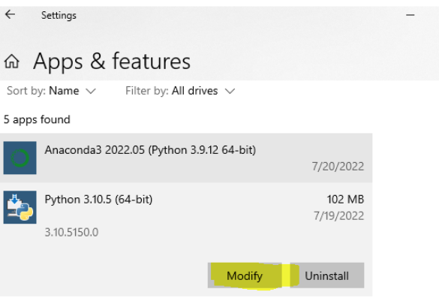
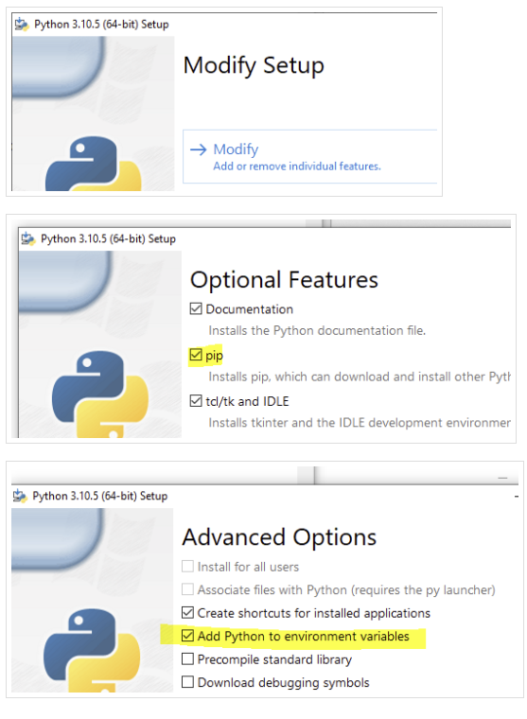

Slide 13
Excel Workbook Set Up

Slide 14
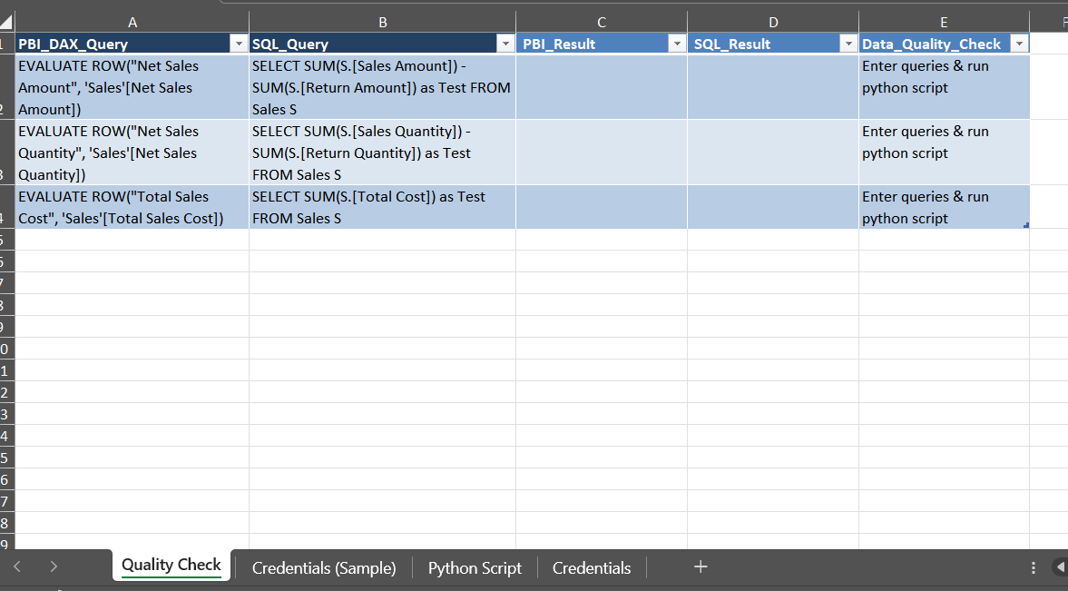

Slide 15
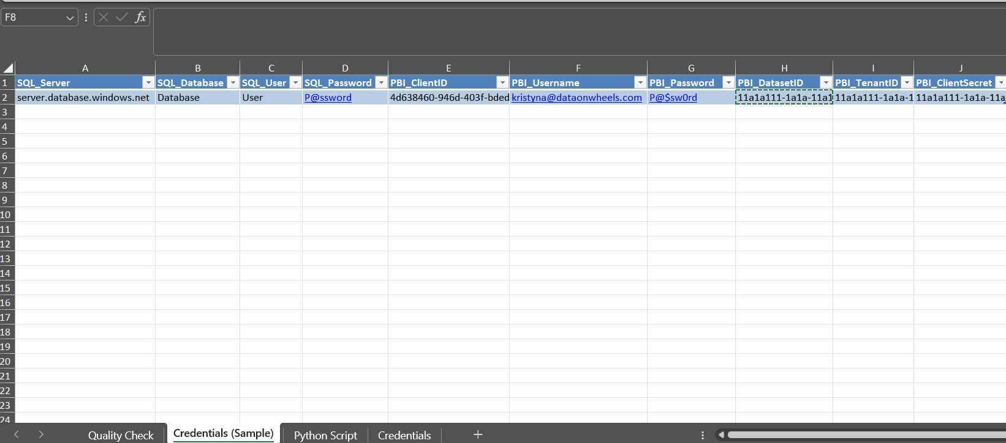

Slide 16
Add the Azure AD to the Workspace

Slide 17
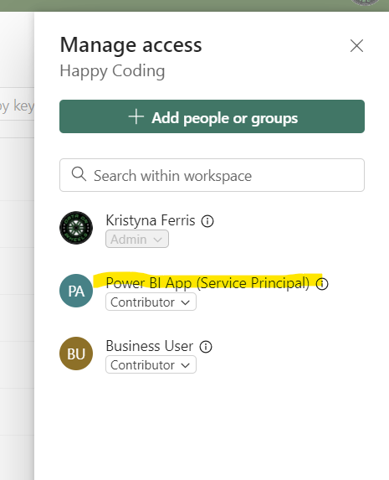
The Service Principal tied to the Azure AD App must have dataset read and build permissions at a minimum.
Contributor access to the workspace also works.

Slide 18

Demo Time!

Slide 19

Questions?

Slide 20
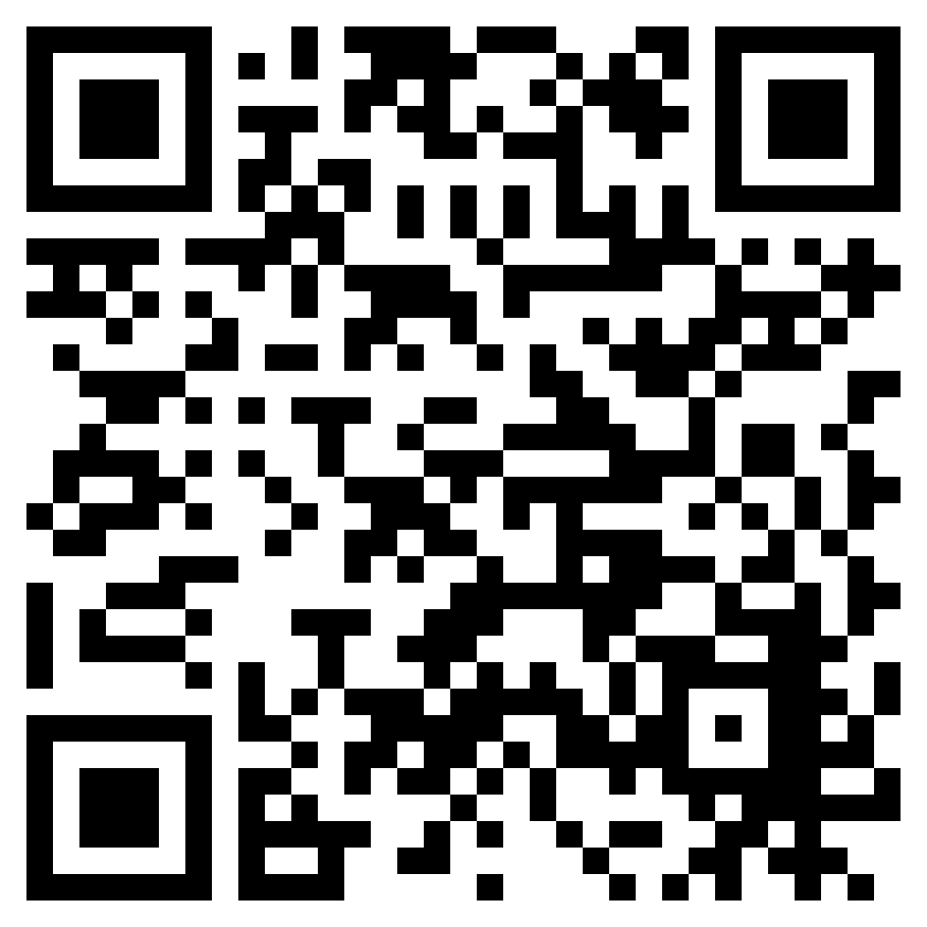
Don’t forget to connect, thanks for listening!
Blog: https://dataonwheels.wordpress.com/
Email: Kristyna@dataonwheels.com
X (Twitter): @data_dragoness
LinkedIn

